Slide 1


Slide 2

Team ID: HKOPAA
Team Name: Team Solid State (Team Appian)
Technology Used: Appian BPM Platform
Application Name: iFlag - I Fight Like a Girl

Slide 3

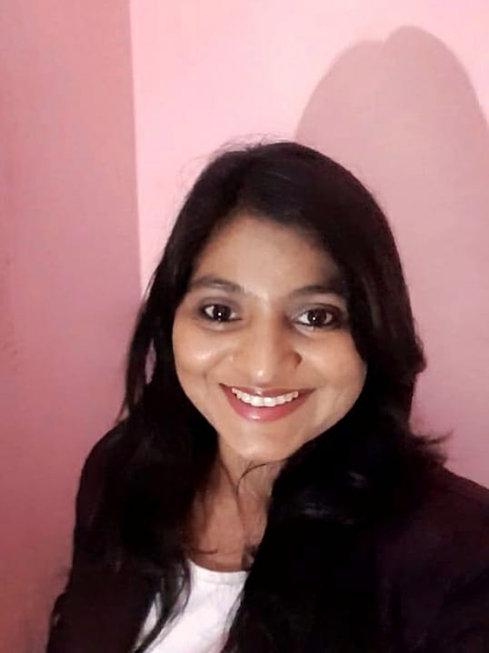
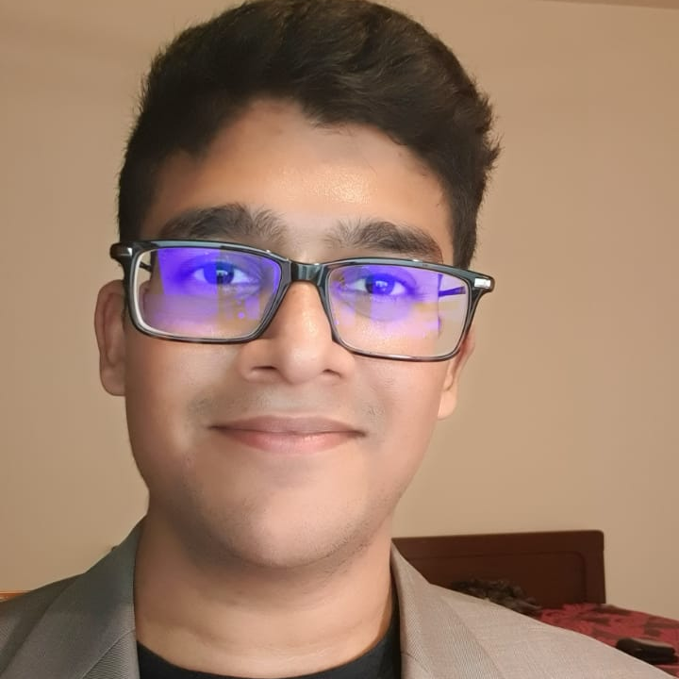
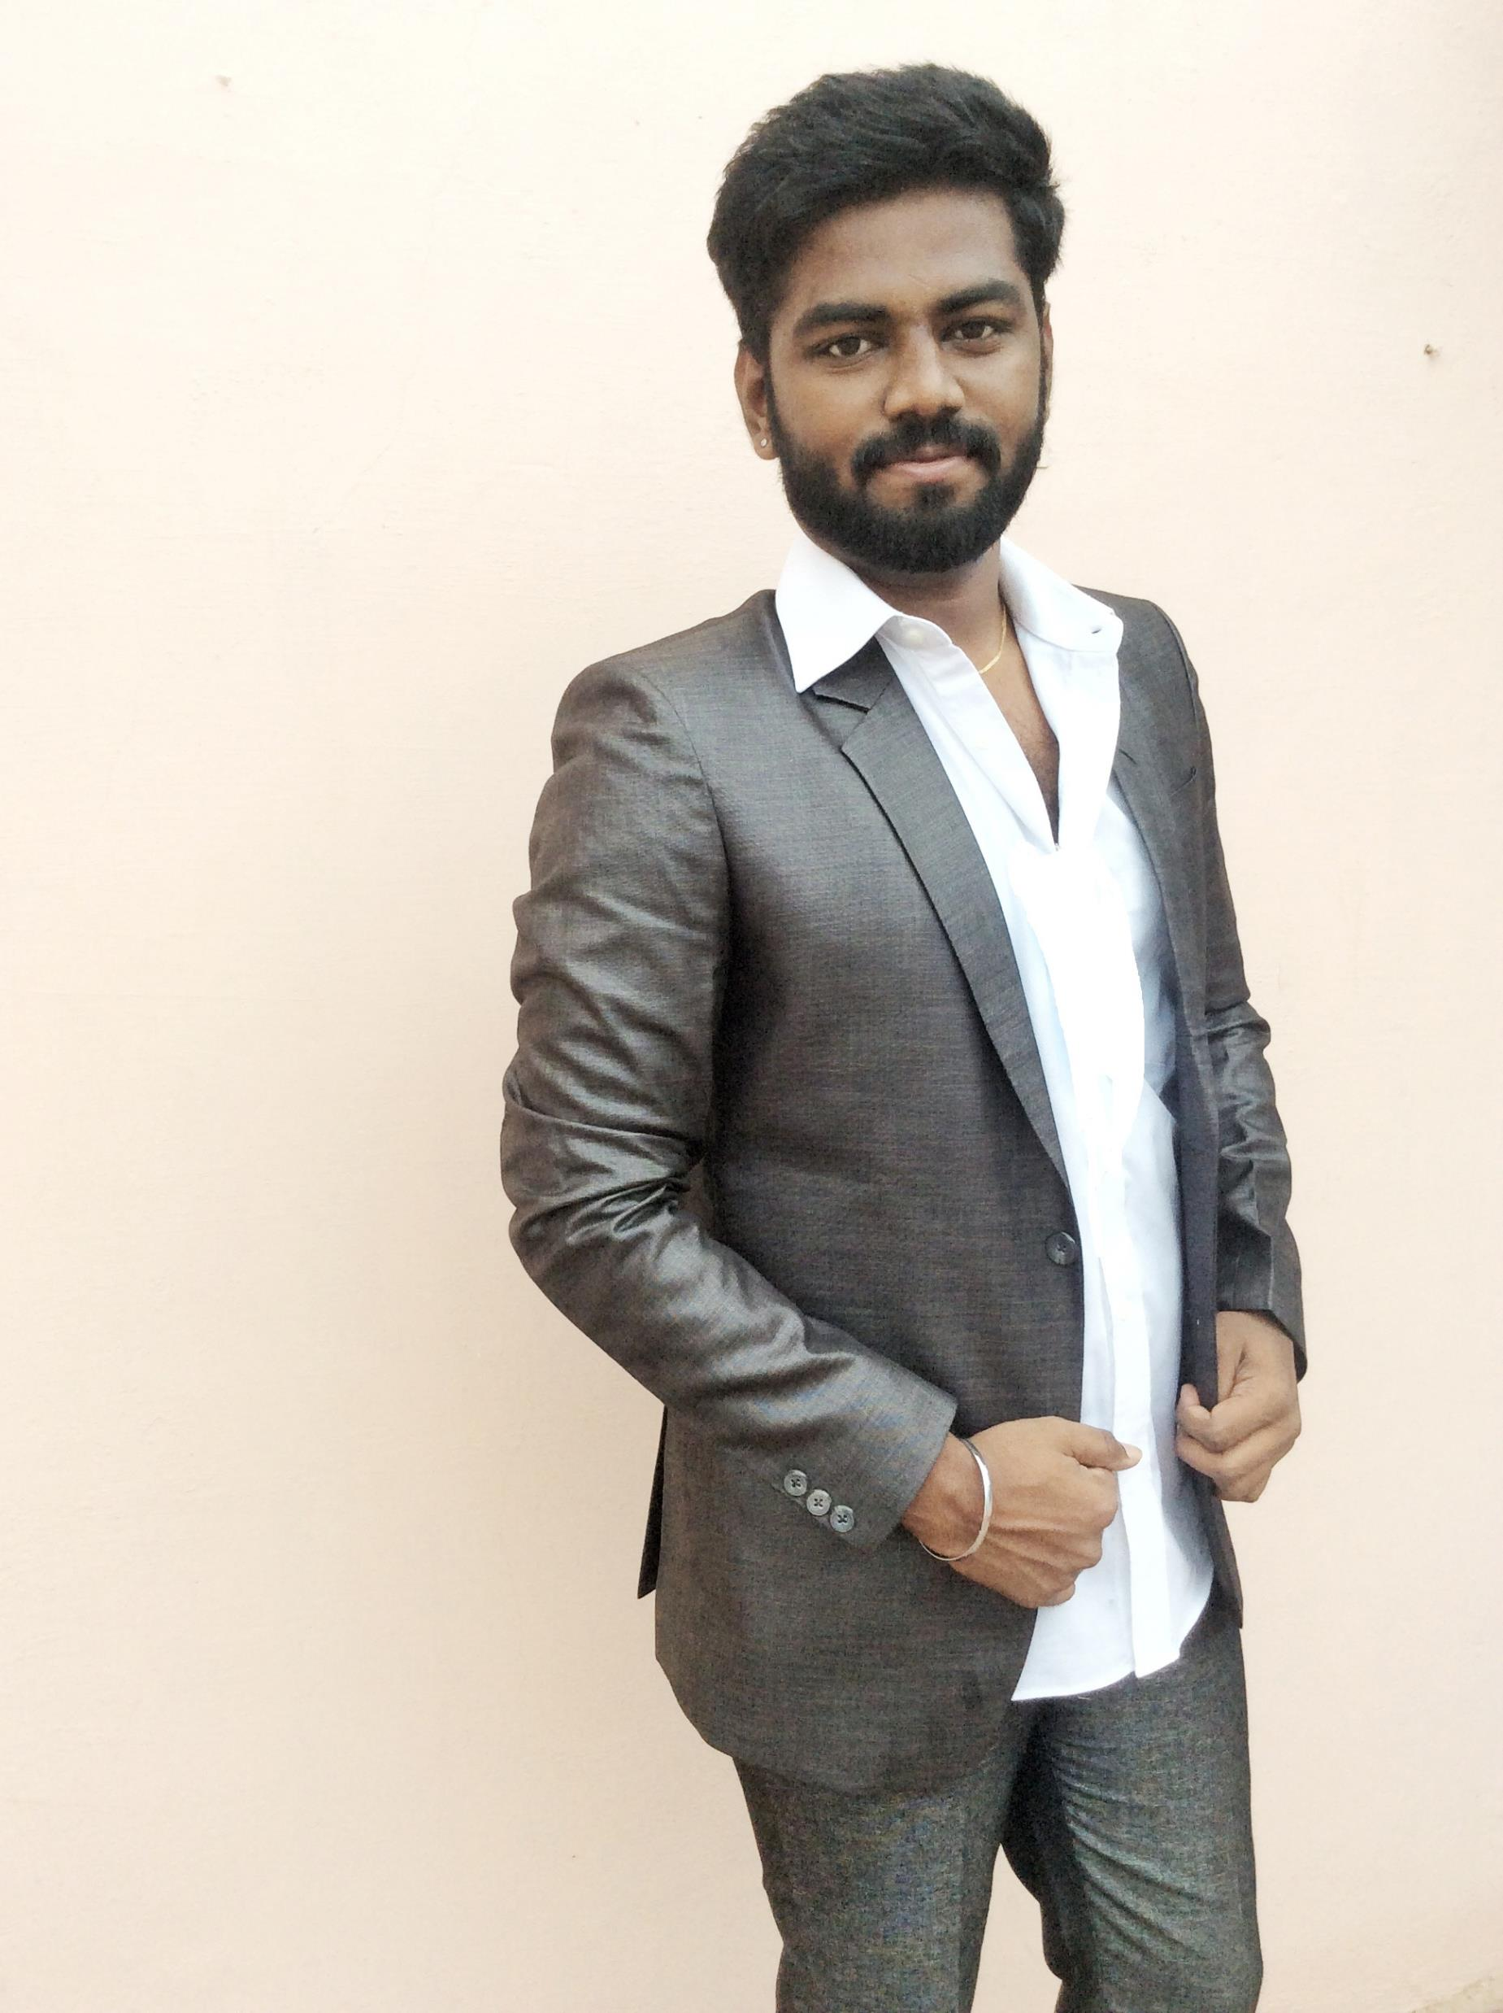
Team Solid State
SHREYA
CADELL
ARUN

Slide 4
Objective:
To build an AI powered application that enables doctors treat breast cancer patients and to prescribe medicines and in a more informed way through machine learning suggestions.
To build a mobile app for patients to support them throughout the treatment cycle

Slide 5

Technology Used :
Appian is a low code business management platform to build web and mobile applications across domains

Slide 6
Why we choose Appian?
Low code platform
Mobile friendly applications
Multiple language feature
Easier Integration capability

Slide 7
Integrations Used
AI/ML API Integration
for enhancing doctor’s treatment with artificial intelligence/ machine learning suggested medicines and clinical treatments
Zoom App Integration
To enable online doctor consultation
FitBit Integration
To integrate and monitor daily activities of the patient
Google Translate Integration
To enable multi language functionality feature for our application

Slide 8
Doctor Site (Web application)
Landing page
My Patients
Display list of patients being treated by the doctor
My Appointments
Displays list of pending appointments to be approved (requested by patient)
Displays list of upcoming events/appointments

Slide 9
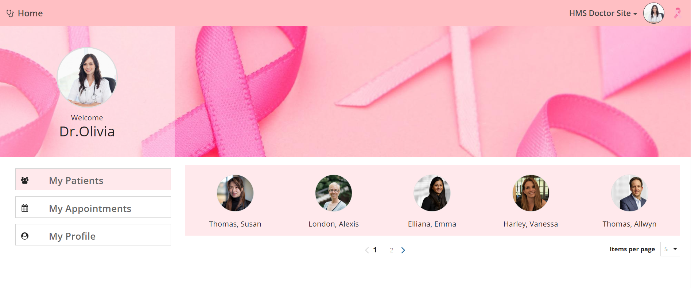
My Patients

Slide 10
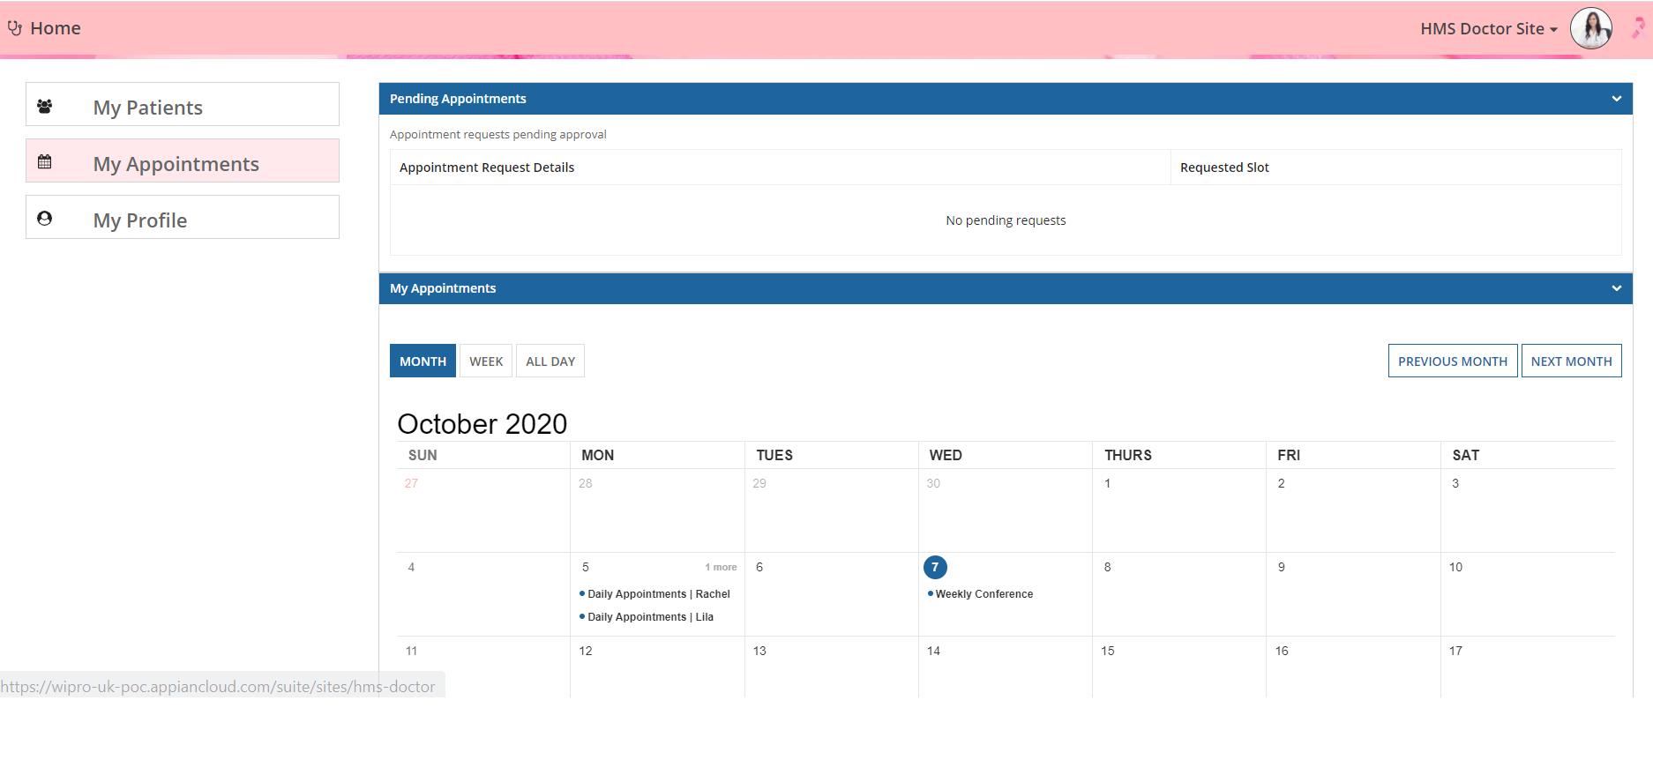
My Appointments

Slide 11
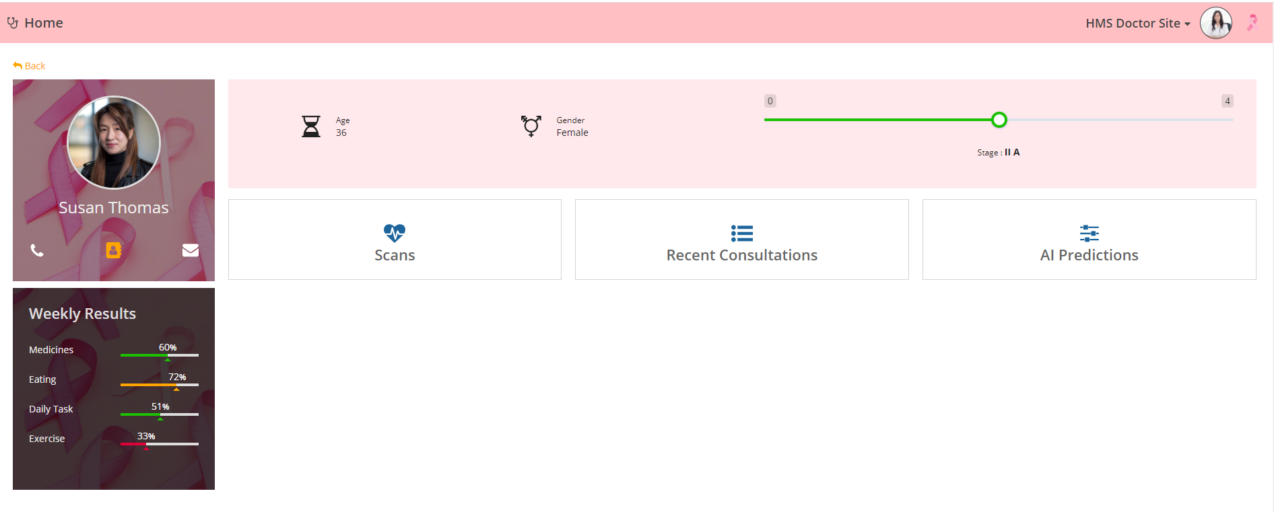
Viewing a Patient Record
Weekly results - Daily intake of food and medicines monitored through FITBIT and through daily tasks completion

Slide 12
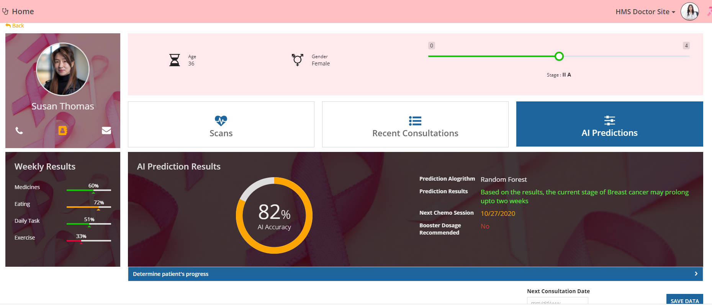
AI Predictions
We have built a small system with Random forest AI prediction algorithm which suggests treatment which runs 1000s of bootstrap data

Slide 13
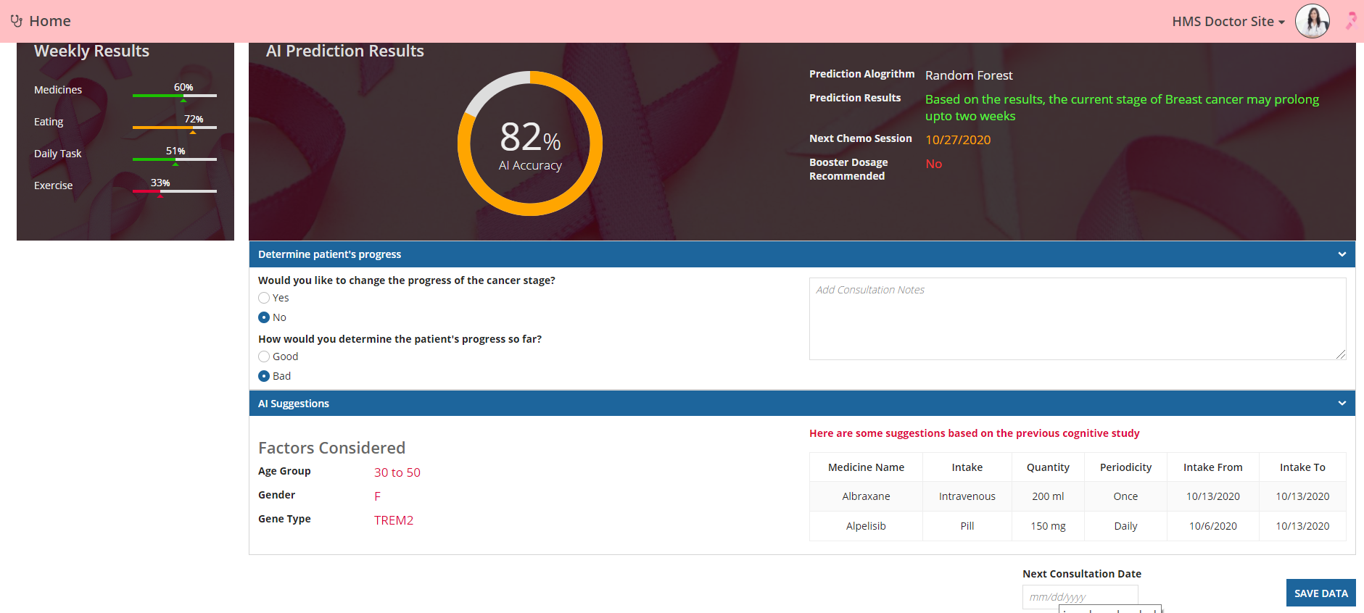
AI suggesting medicines:

Slide 14
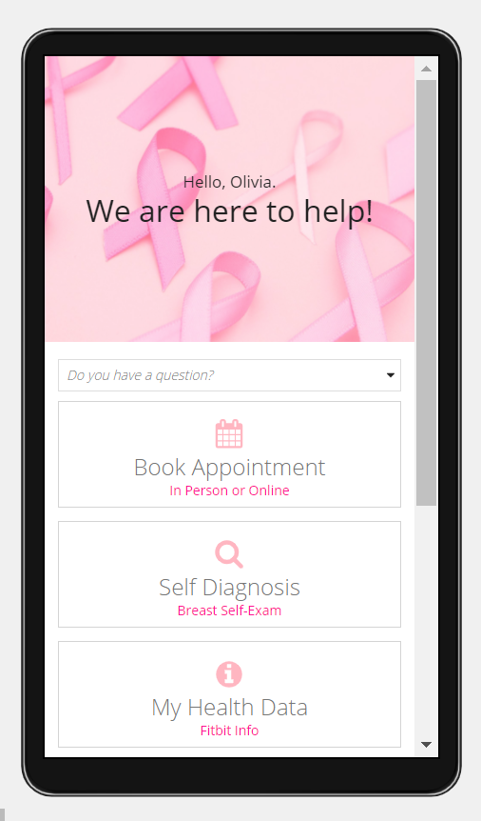
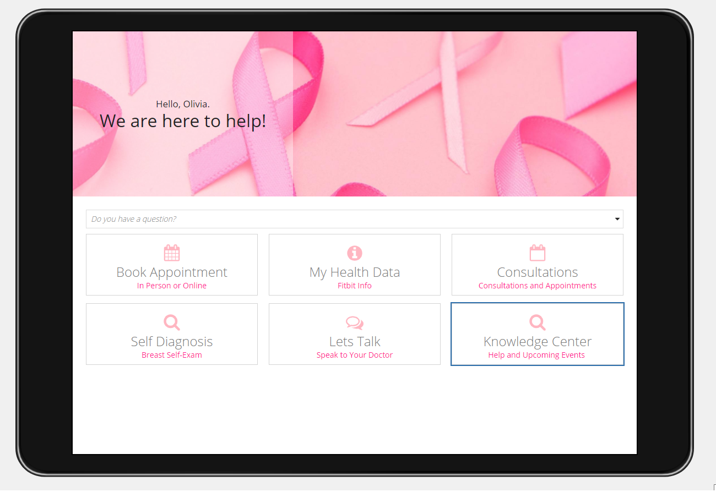
Patient Site

Slide 15
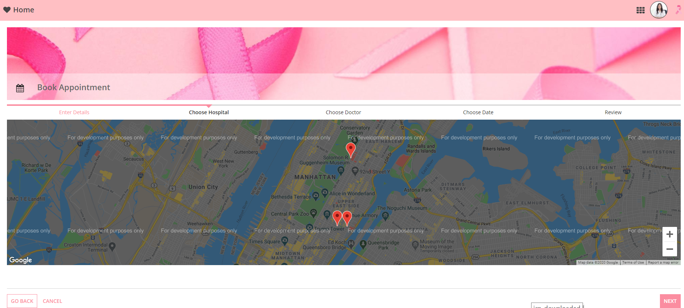
Book Appointments patient can consult nearby doctor using google maps

Slide 16
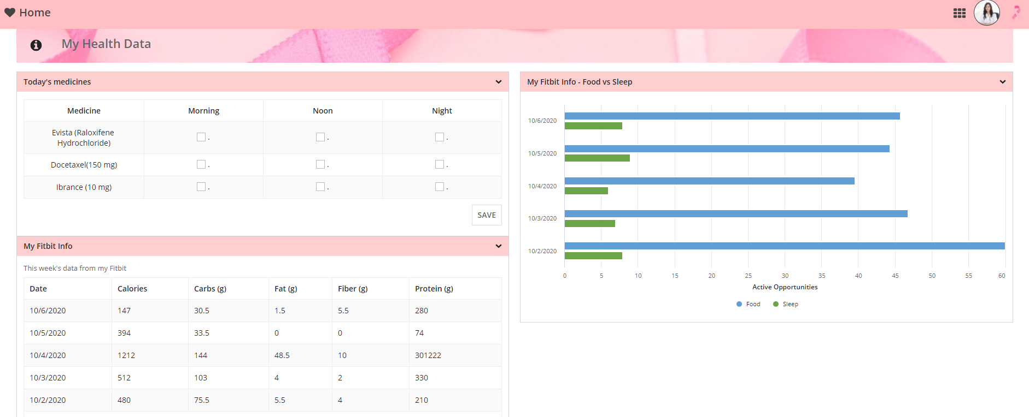
My Data shows data from FITBIT integration

Slide 17
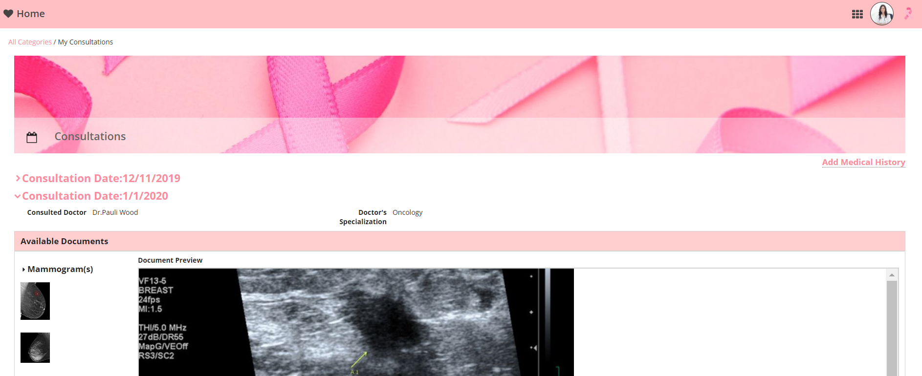
Consultations - shows all past consultations – data persisted from book appointment workflow

Slide 18
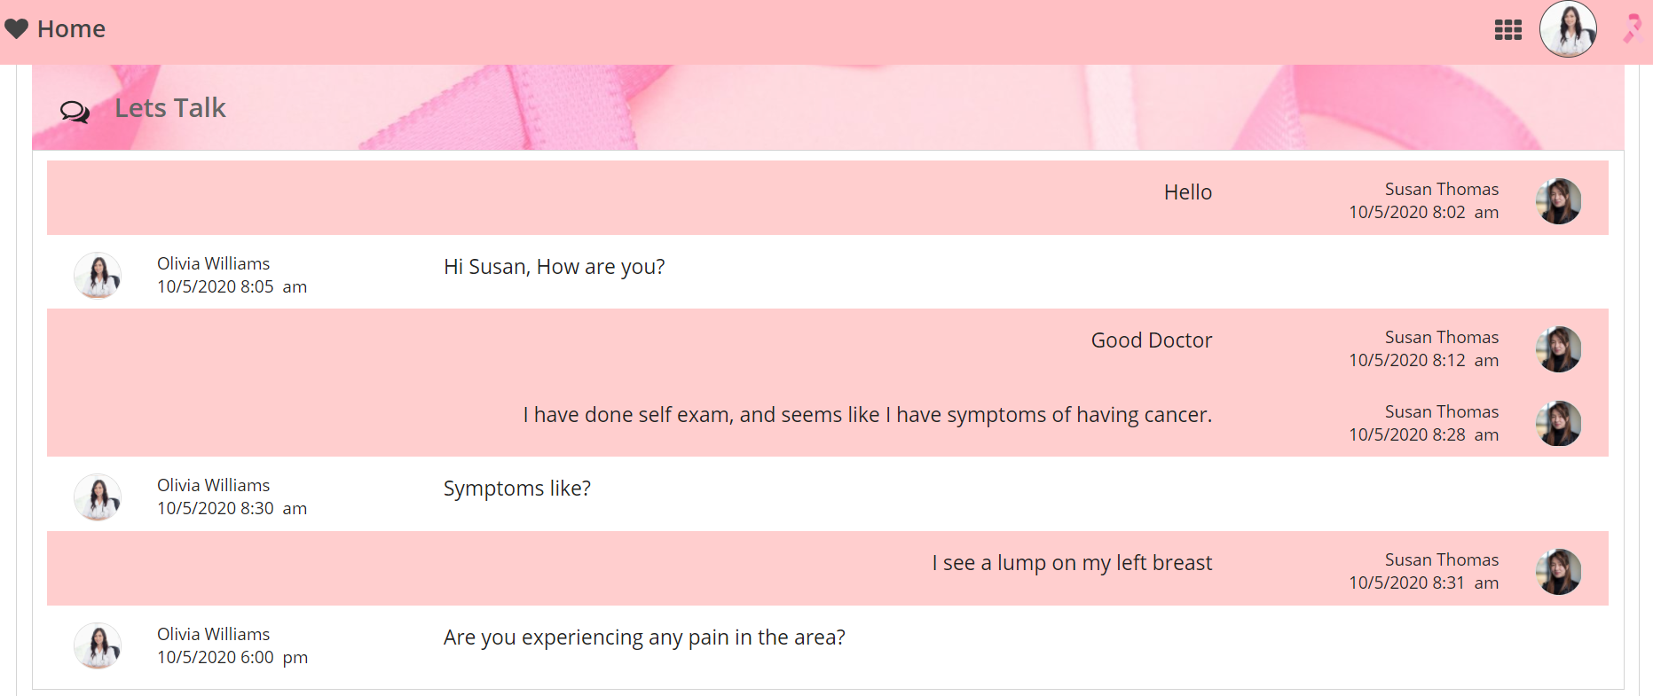
Lets talk non-live chat option with the doctor to clarify doubts anytime

Slide 19
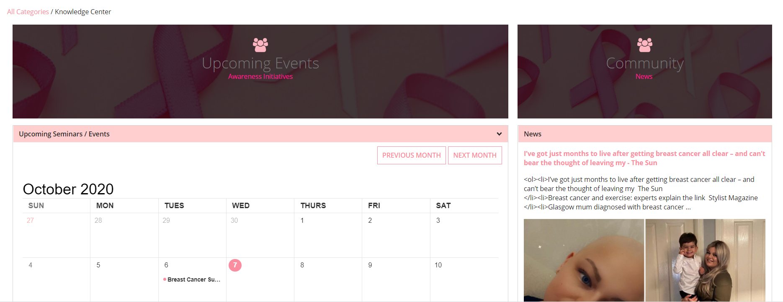
Knowledge Center gives awareness through news and upcoming conferences

Slide 20
Try it out Please try accessing our sites which we developed through below links and credentials
https://wipro-uk-poc.appiancloud.com/suite/sites/hms-patient-site
Login Id: patient
Password: hackathon1
https://wipro-uk-poc.appiancloud.com/suite/sites/hms-doctor
Login Id: doctor
Password: hackathon1

Slide 21
Presentation links:
Project pitch
https://youtu.be/aJZWxiqOQVA
Full demo
https://youtu.be/9eEitd4vmyE

Slide 22
Accomplishments
We always wanted to solve a real-world problem and to build a simple healthcare solution that would bridge gaps. This app could be very useful to hospitals, doctors and patients as it adds great value to their lives.

Slide 23
What next for iFlag
We would like to experiment with more data so as to train our model and we can progress better with the machine learning aspect of this application. We would also like to understand and address more pain points the doctors and patients face.

Slide 24
Thank you

